Slide 1

Hotel Aggregator Analysis with Power BI

Slide 2

Problem Statement
The objective of this internship project is to conduct an in-depth analysis of a dataset comprising hotel aggregator listings using Power BI. The dataset includes diverse attributes related to listings, hosts, reviews, and availability. The primary aim is to develop comprehensive visualizations and insights to uncover trends, patterns, and factors influencing the performance of these listings. Through Power BI, interns will explore key metrics such as pricing, availability, host characteristics, and review scores to derive actionable insights aimed at enhancing the overall quality and competitiveness of the listings.

Slide 3

Dataset Description
The dataset includes various attributes such as unique identifiers for listings and hosts, URLs, descriptions, neighborhood overviews, picture URLs, and numerous other details capturing information about hosts, location, property types, room details, amenities, pricing, availability, reviews, and other relevant factors.

Slide 4
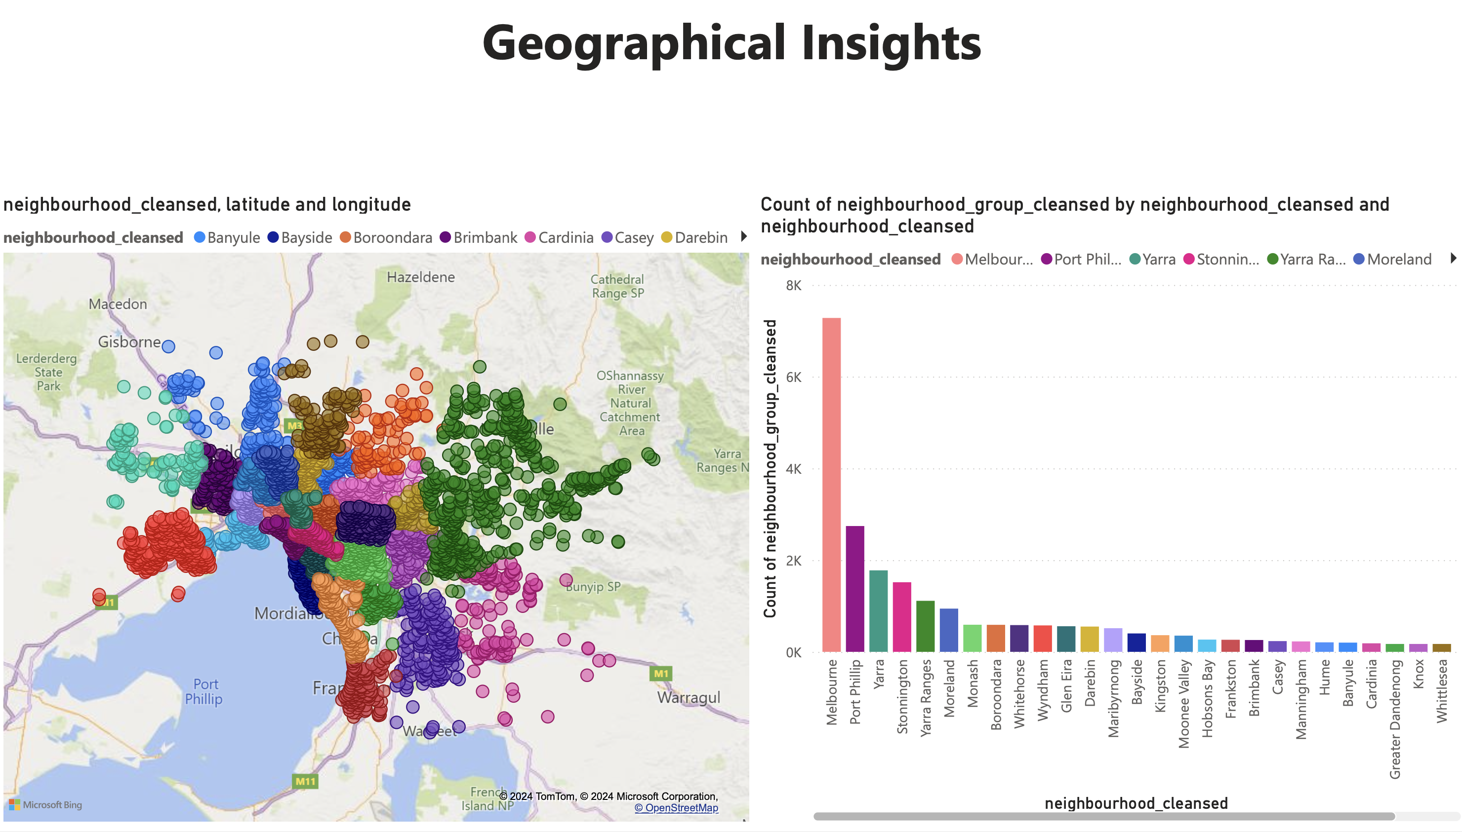

Slide 5
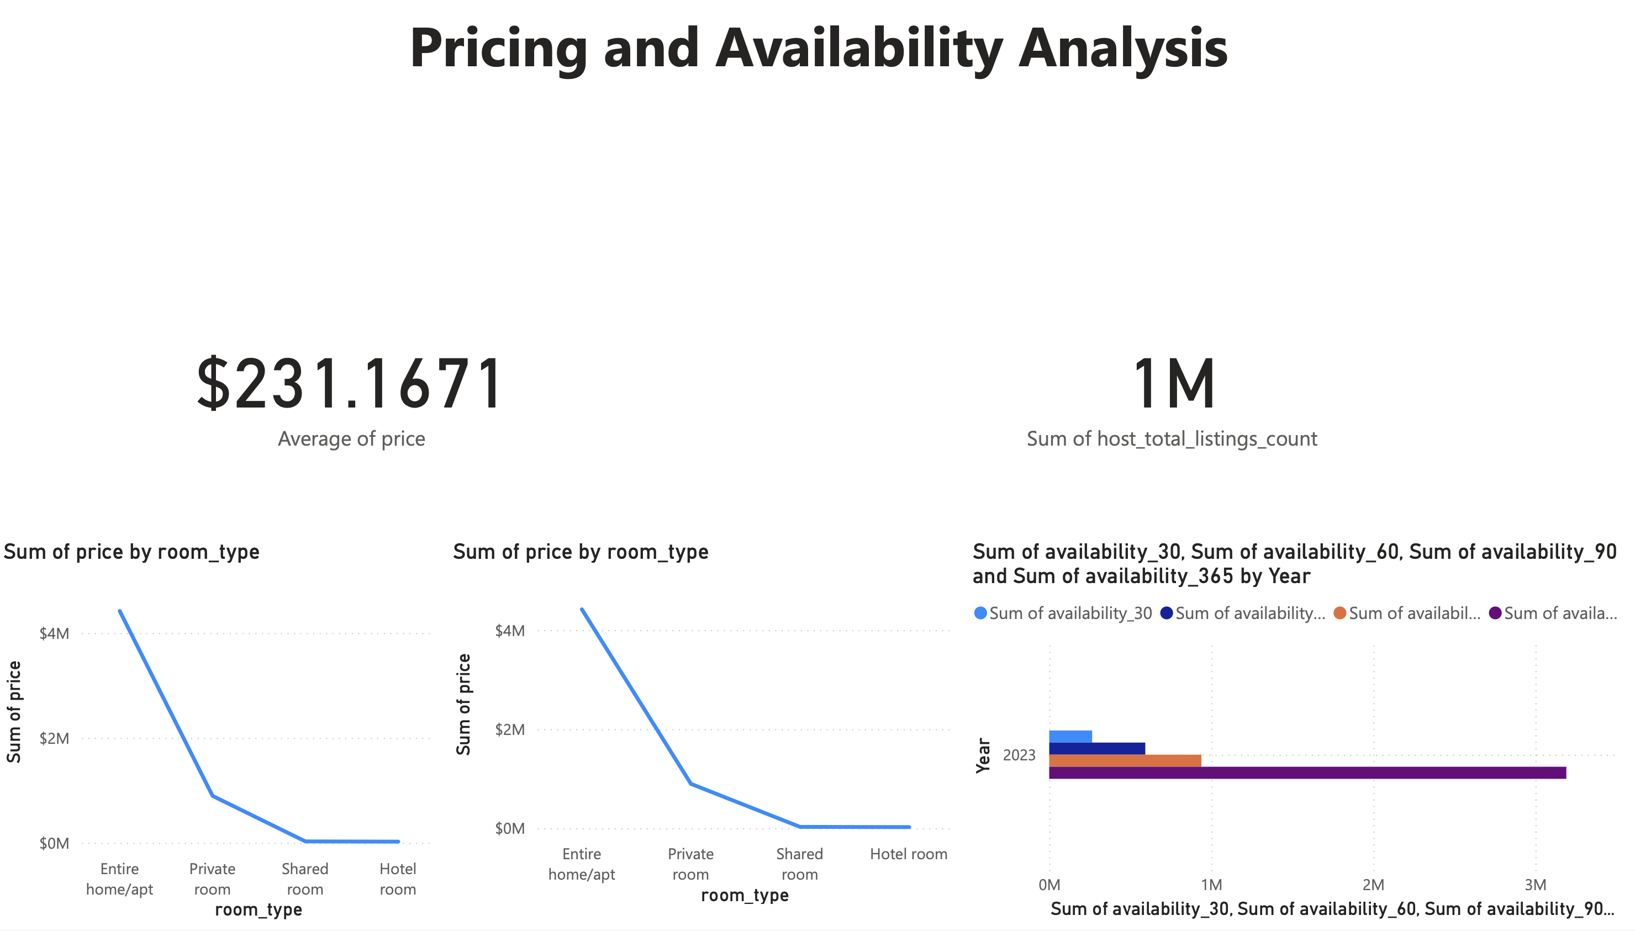

Slide 6
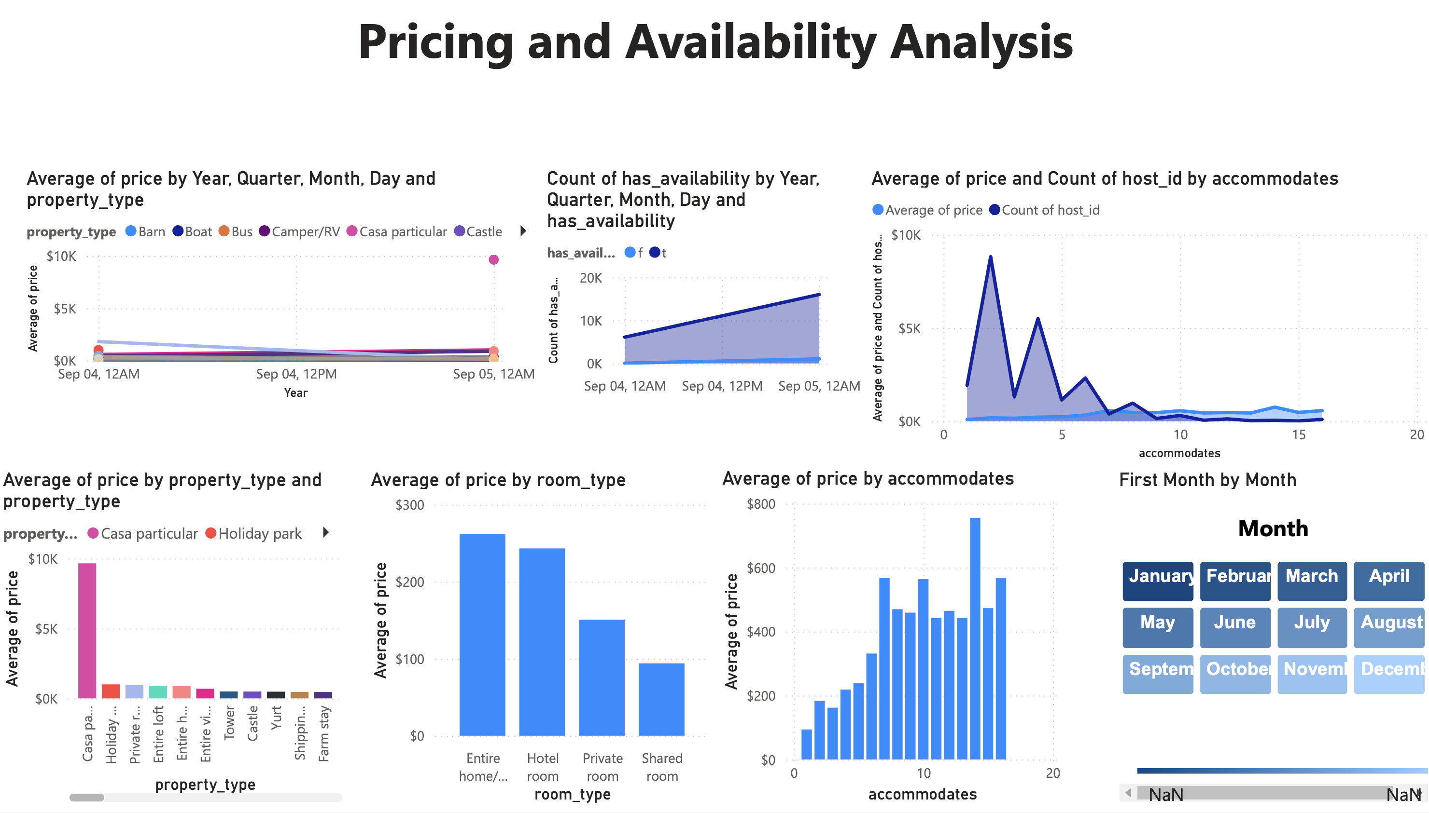

Slide 7
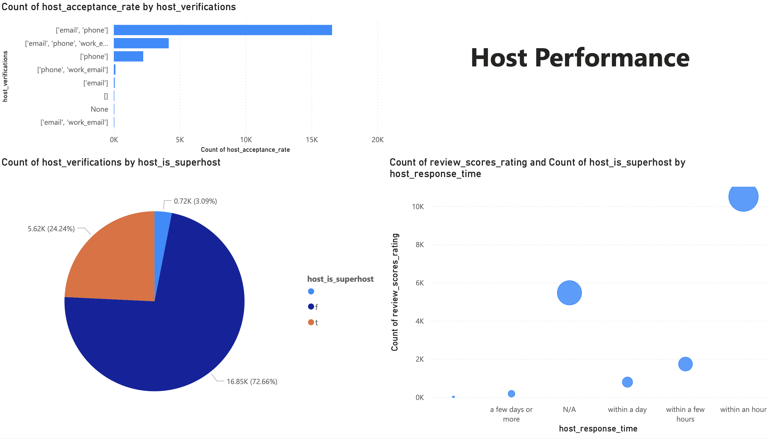

Slide 8
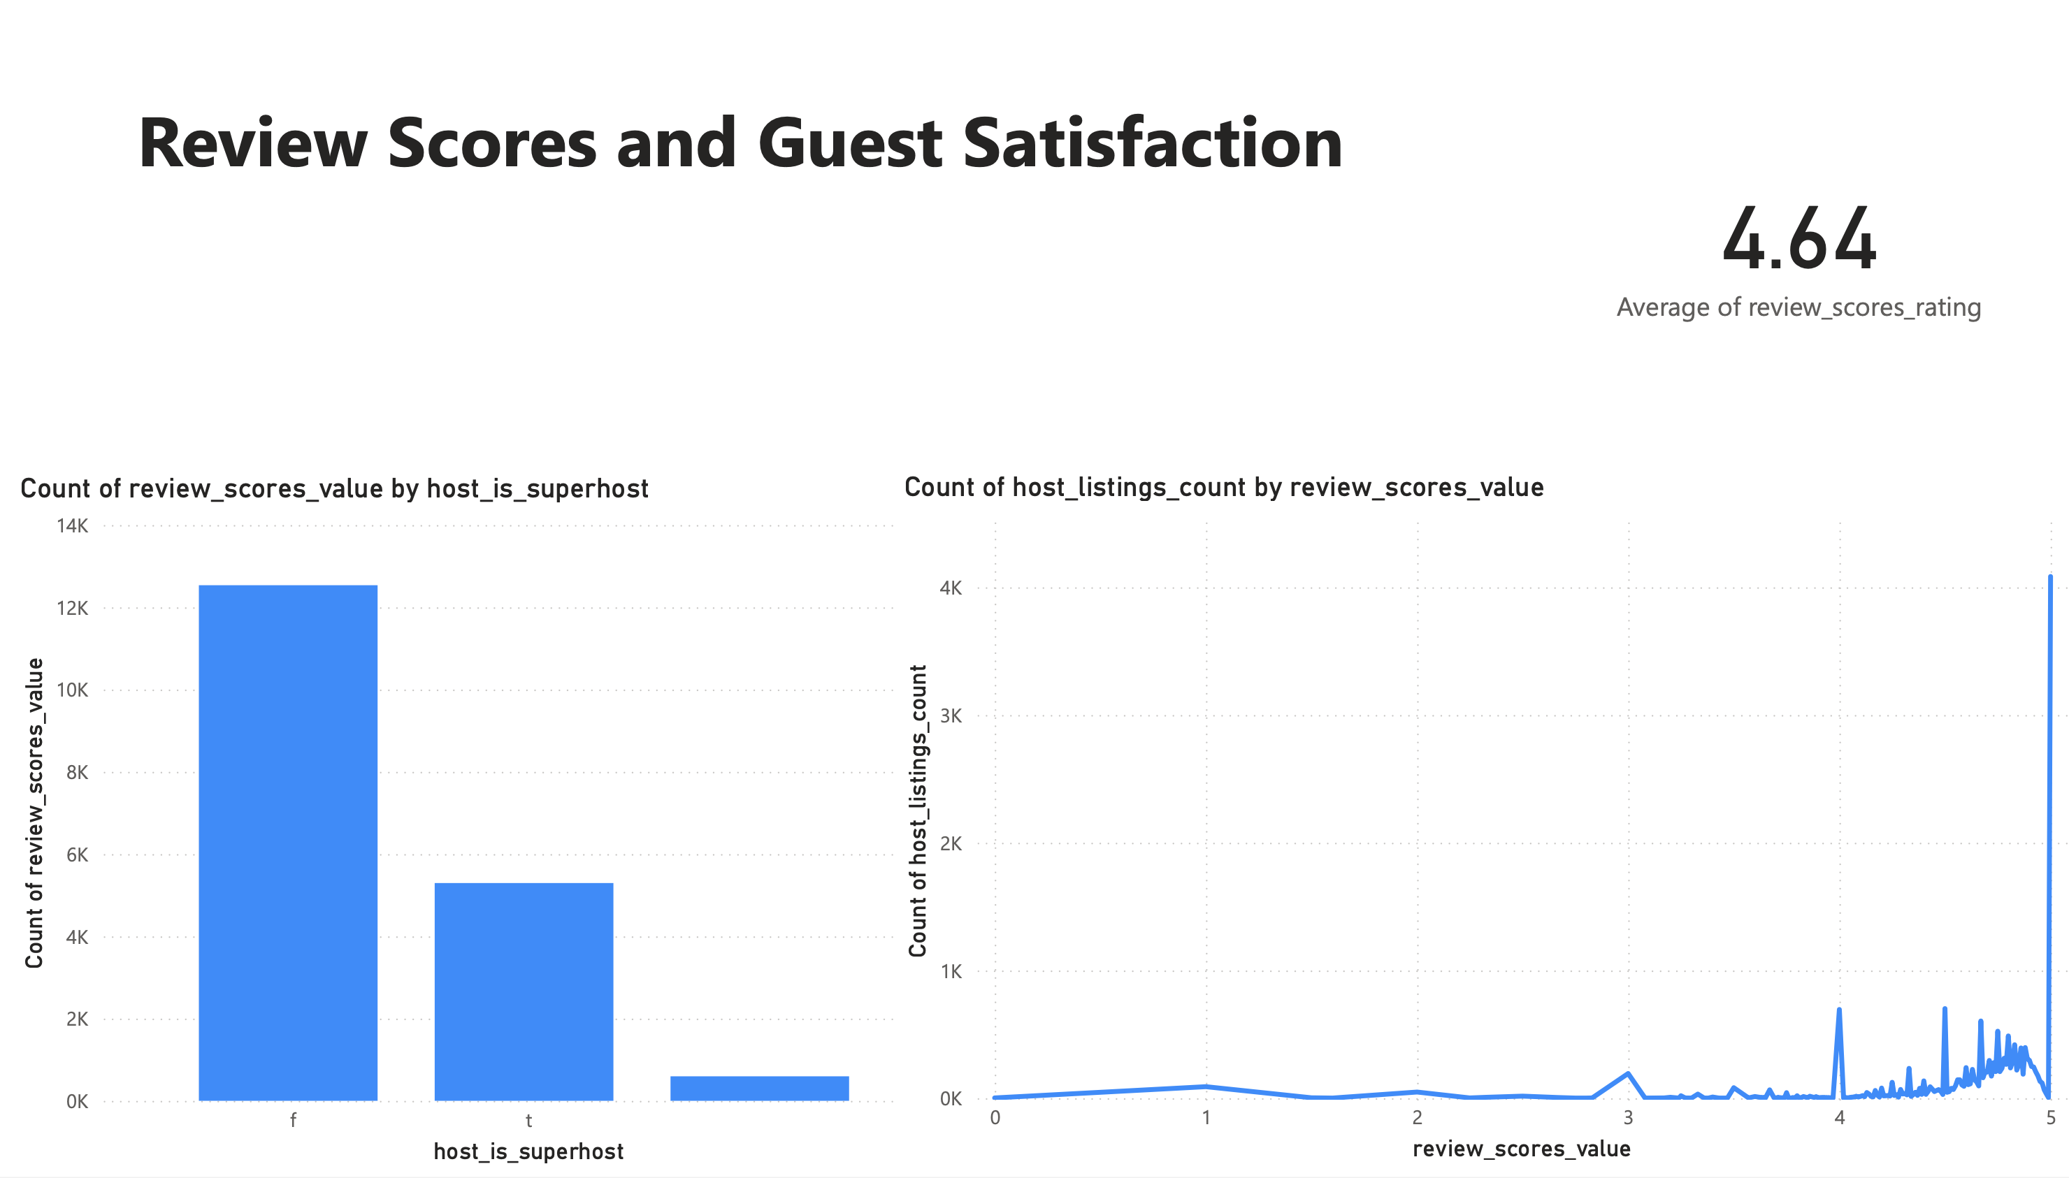

Slide 9
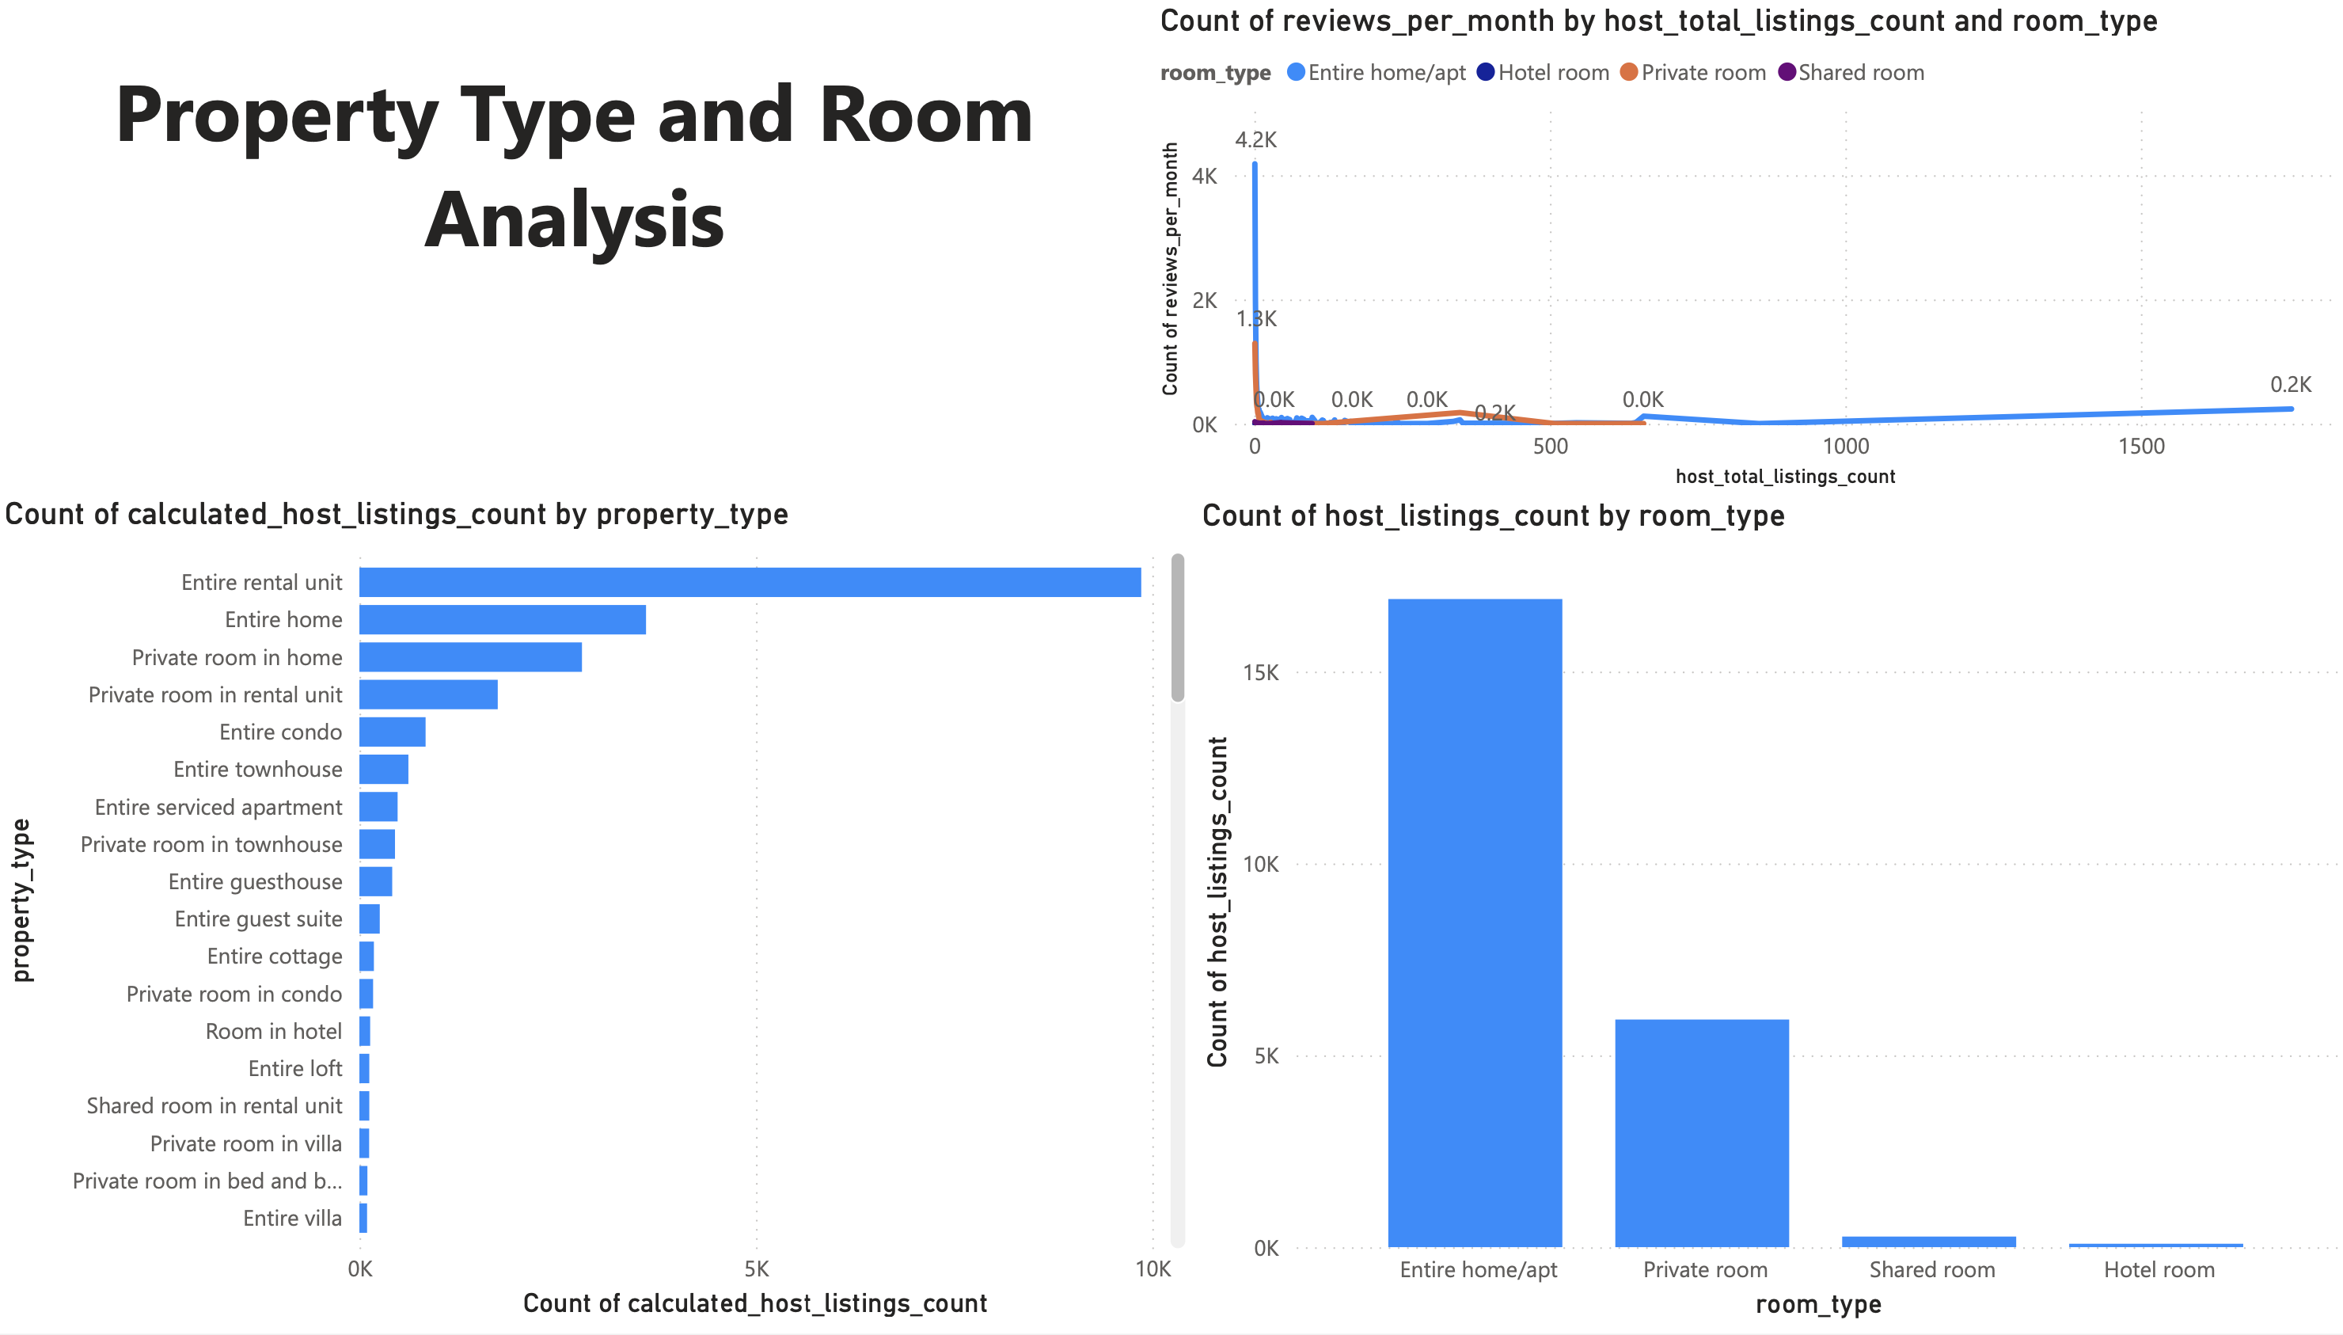

Slide 10
Recommendations for Hosts
Prioritize Guest Satisfaction: With a significant number of listings receiving 5-star reviews, hosts should prioritize guest satisfaction by maintaining high standards of cleanliness, communication, and overall guest experience.
Price Strategically: Utilize insights from the pricing analysis to set competitive prices for listings. Understand market trends and adjust pricing accordingly to attract guests while maximizing revenue.
Enhance Verification Processes: Aim to achieve Superhost status by meeting criteria such as maintaining high response rates, receiving positive reviews, and completing necessary verifications. Superhosts tend to receive more positive reviews, enhancing credibility and trust.
Optimize Response Time: Improve response times to guest inquiries, as faster responses are associated with higher guest satisfaction. Implement tools or strategies to streamline communication and increase booking conversion rates.

Slide 11
Recommendations for the Aggregator Platform
Facilitate Host Education: Offer educational resources and training programs based on analysis insights. Topics can include property management best practices, communication strategies, and maximizing listing potential to help hosts enhance their hosting skills.
Streamline Verification Processes: Simplify verification processes and provide clear guidelines based on analysis findings. This makes it easier for hosts to achieve and maintain Superhost status, fostering trust and credibility on the platform.
Encourage Feedback Loop: Establish a feedback mechanism based on analysis insights to allow hosts to provide input on platform improvements and areas needing additional support. This promotes a collaborative relationship, driving continuous improvement and alignment with host needs.

Slide 12


